Slide 1
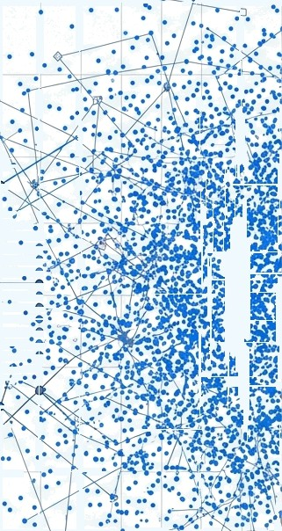








PROCESS MINING & AI REVOLUTIONIZE
E-COMMERCE
ANALYTICS
From process discovery to behavioral prediction with Llama 3 and Streamlit.
•
"*
”nel* i.• i '.+ r:‹.5
y
.
.
OBIETTIVO:
Transform browsing logs into actionable conversion strategies..
Pipeline Python integrata con Groq Cloud (Llama 3.3).
’• "
•
TECNOLOGIA:

Slide 2
THE CONTEXT: THE OPACITY OF BIG DATA
SCHEDA DATI TECNICA @
E-commerce datasets contain millions of events. Without causal structure, this data remains indecipherable “noise.”
Without Process Mining, we see WHAT happened, but not HOW or WHY.
Volume Dati
105 MB (File Grezzi)
Sfida Tecnica
Cleaning null value & Timestamp non
Standard
Optimization
Selection of first 5000 sessions unique per performance
SNIPPET DI CODICE (PYTHON/PANDAS)
df = df.dropna(suDset-['user session']) unique_sessions = df['user_session'].unique()[:5000]

Slide 3
The System Architecture:
From Logs to Dashboard
1. Ingestion |  | 2. Discovery | 3. Evaluation | 4. Intelligence | S. Visualization
Pandas Cleaning & Sorting |  | PM4PY Algorithms (Alpha, Heuristic, | Calculation Fitness Precision | GenAl Reasoning (Llama 3) | Streamlit Dashboard
 |  | Inductive)
preProcessing.py |  | processDiscovery.py | Metrics Calculation | IImReasoning.py | User Interface
An automated flow that powers Business Intelligence in real time.

Slide 4
Struttura del Dataset
event_time: Precise timestamp of the event (UTC format).
event_type: The action performed by the user (view, cart, purchase).
product_id / brand / price: Key data of the interacted product (ID, brand and price).
category_code: Product category (e.g. electronics.smartphone), essential for segment analysis.
user_id: Unique customer identifier for long-term tracking.
user_session: Single session ID; fundamental for mapping the purchasing path (customer journey).

Slide 5
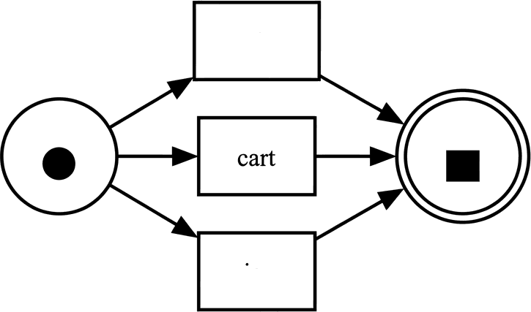
Discovery Algorithm 1: Alpha Miner
Operation: Based on direct causal relationships (A follows B).
Result: A clean but schematic Petri net.
Limitation: Struggles to handle complex loops and real data noise, sometimes creating connections that are too rigid.
Metric: Low Fitness on complex logs.
purchase
view

Slide 6
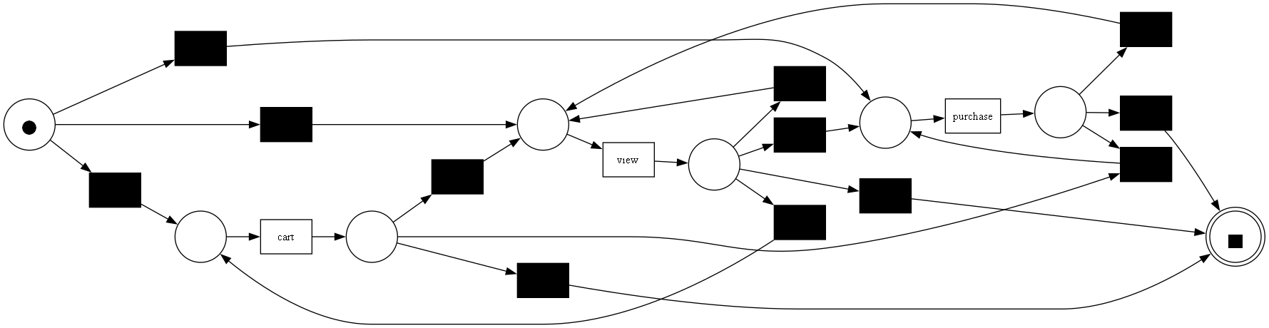
Discovery Algoritmo 2: Heuristic Miner
Innovation: Use frequency thresholds to ignore rare paths (noise).
Insight: Observe the weights on the arcs. The system does not just map the possible, but the probable.
Advantage: Representation
more realistic behavior
mass.

Slide 7
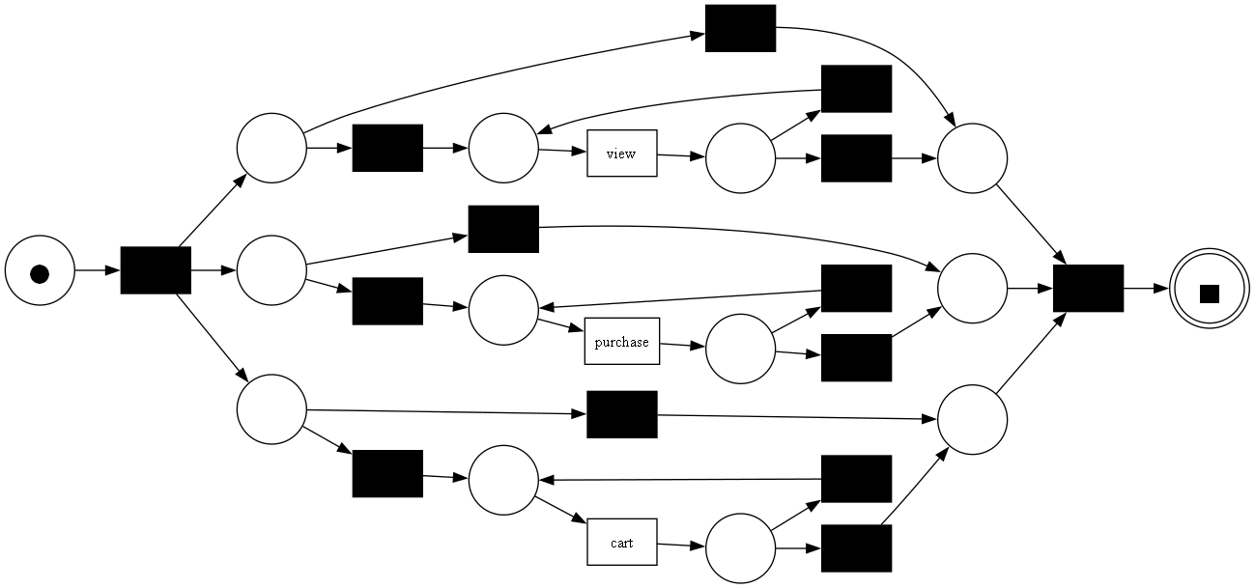
Discovery Algoritmo 3: Inductive Miner
Approach: Divide and Conquer via Process Trees.
Structure: Uses logical operators (XOR, AND, LOOP) to segment the stream.
Guarantee: Always produces 'sound' models (no logical dead ends or deadlocks).
Detail: Note the "xor loop" nodes that allow controlled repetition of activities.

Slide 8

Benchmarking: Which Model Tells the Truth?
Precision
Simplicity Leggibilità)
Algorithm
(Aderenza)
Alpha Miner
0,69
1,00
0,0909
Too Simple
Heuristic Miner
0,99
0,92
0,0185
Great for visual insights
lnductive Miner
1,00
0,90
0,0145
Best for Automation
“There is no perfect model, but the
most useful model for the business objective.”

Slide 9

The Virtual Analyst: GenAI Integration (Llama 3)
Beyond visualization, towards reasoning.
Reasoning Engine (Groq API)
LIama-3.3
Strategic Insight
Diagnose bottlenecks and make business suggestions in natural language.
Exstract Data
(Python)

Slide 10


Predictive Intelligence: Anticipating the Next Move
User Input
[ VIEWI ] [ CART ]
Calculation Process
1. Historical Probability Calculation(Pandas Shift)
2. Semantic Interpretation (Llama 3 Context)
Output
EXIT (High Probability)
60%
Risk of abandonment
Opportunities
40%
PURCHASE

Slide 11
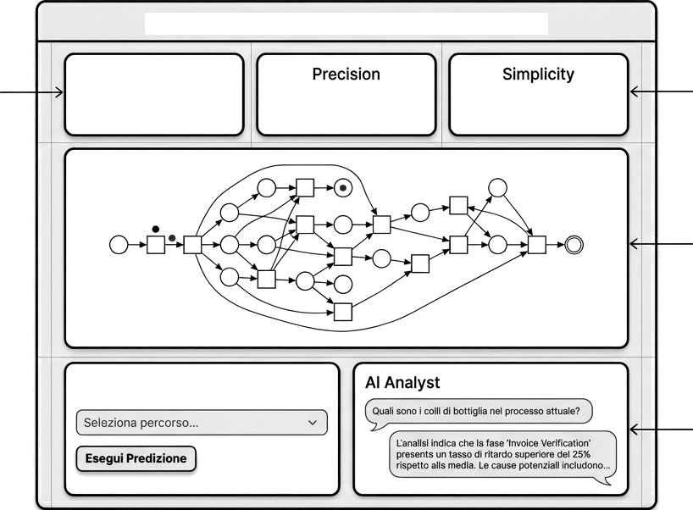
The Streamlit Dashboard: Interactive Control Room
Process Mining Dashboard & AI Prediction
Metrics real-time
Fitness
a. 98 ò . 85 ò .7ó
Metrics real-time
Graph view
Next Event Prediction
Interface
Chatbot Llama 3

Slide 12

Anomaly Detection in Natural Language
Chat Management
Natural interaction: The user asks free questions as if talking to a human consultant.
Intuitive Answers: The system processes complex data and responds in natural language, without technical jargon.
No Technical Skills: You don't need to know coding or process mining to get strategic insights.
Chat with your Data
Dove stiamo perdendo clienti?
Analysis completed. The Heuristic model shows a significant discrepancy between “Add to Cart” and “Purchase”. The main bottleneck. The main one is in the Checkout. I suggest checking the complexity of the payment form.

Slide 13

Summary of Results:
View
Cart
Purchase
8691 Event
460 Event
316 Event
Window Shopping Domain (Many Loops)
Drop-off Critico (Solo il -5% procede)
Conversion Rate Solido (68% dal carrello)
The problem is not closing the sale, but convincing the user to select the product.

Slide 14




Conclusions: Towards a Predictive CRO
Traditional Approach Process Mining + AI
Reactive Analysis
• “We lost a customer"
Static Reports
Proactive Management
” The customer stands for abandon, let's act”
Conversational Intelligence
Logs are not garbage, they are the unheard voice of the customer.

Slide 15






Appendix: Technology Stack
Core language Python 3.10+
Mining Engine
PM4PY (Process Mining for
Python)
Data Manipulation
Pandas
Data Manipulation
Pandas
Generative AI
Groq Cloud API (Llama 3.3)
Visualization & UI
Graphviz & Streamlit

